Slide 1

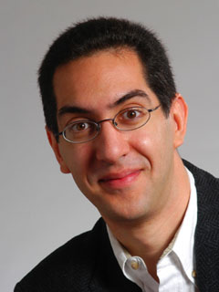
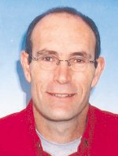

2012-03-07
Denver, CO
Demystifying Computing
with Magic, continued
Dan garcia
UC Berkeley
David ginat
Tel-Aviv University

Slide 2

Special Session Overview
Motivation
The 7 magic tricks
  Real-Time 4x4 Magic Square
  Left/Right Game
  The Tricky Dice
  The Numbers Game
  Find the Card
  Guess Your Age
  Guess Your Birthday Day of Week
Reflection
Other References
YOU contribute your tricks

Slide 3
Magic is Fun!

Slide 4
but Magic can be much more than fun!

Slide 5
Magic can Motivate, Illustrate, Elaborate…
Computing notions
  Discrete math terms: e.g., permutations,
  Problem representation: e.g., binary digits
  Algorithmic patterns: e.g., sorting
  General notions: e.g., symmetry
Problem solving
  Problem decomposition
  Simplification, Generalization
  Backward reasoning
  Analogy (transfer)
  Problem representation

Slide 6
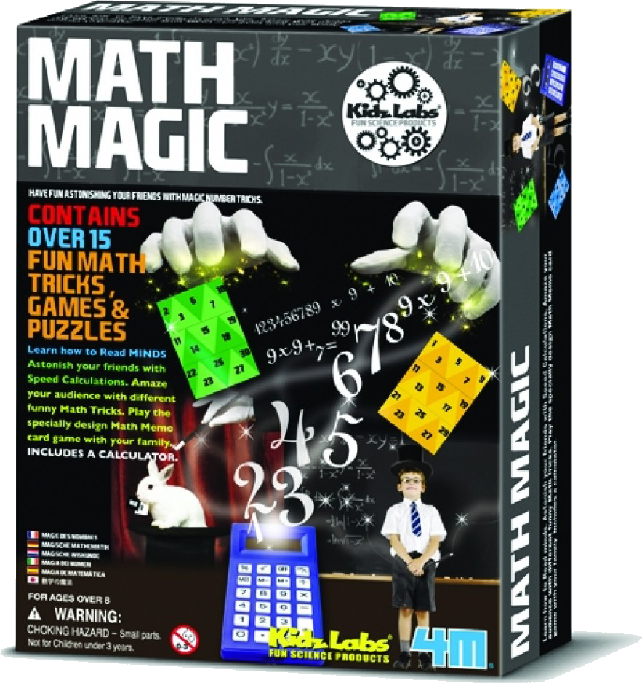
Real-Time 4x4 Magic Square
Volunteer is asked for a number N from 25-100
You create a magic square, where the sum of each row, column and diagonal is N
Source:
All add to…
N
• | • | • | •
• | • | • | •
• | • | • | •
• | • | • | •
N
N
N
N
N
N
N
N
N

Slide 7
How it Works; What Students Learn
Mechanics
  Make-Magic-Square(N)
  Have a grid with the value already written faintly (or memorize it)
What they learn
  Value of lookup table
  Correctness proof
  Decomposition
  Algebraic representation
  Value of randomness
    8 rotations-and-flips
N
N-20 | 1 | 12 | 7
11 | 8 | N-21 | 2
5 | 10 | 3 | N-18
4 | N-19 | 6 | 9
N
N
N
N
N
N
N
N
N

Slide 8
Left/right Card Game [IOI’96]
A line of 2N integer cards
Two players, alternating turns
Each player, on her turn, takes a card from one of the line ends (left or right)
The winner is the player whose sum of N cards is larger

Slide 9
The Magic
A volunteer from the audience arranges the line of 2n cards as she wishes
The magician looks at the line for a few seconds; then turns his back to the cards
The player plays against the magician, while the magician does not see the line of cards
The magician is the 1st player, never loses

Slide 10
A Greedy Heuristic
5
9
8
4
7
5
1
2
9
6
3
3
Take the larger end
But, maybe the larger end yields a good move for the opponent?

Slide 11
Another Greedy Heuristic
5
9
8
4
7
5
1
2
9
6
3
3
Take the card from the end with the better “delta”
But, is it sufficient to look locally?

Slide 12
Extreme-Values Heuristic
5
9
8
4
7
5
1
2
9
6
3
3
Identify the locations of the larger cards, and try to get these cards
But, how to guarantee getting them?

Slide 13
A Deterministic Approach
5
9
8
4
7
5
1
2
9
6
3
3
5
9
8
4
7
5
1
2
9
6
3
3
Apply dynamic programming - solve the game for: all pairs, all triples, all quadruples …

Slide 14
Dynamic Programming
5
9
8
4
7
5
1
2
9
6
3
3
Not simple to program
Requires O(N²) time, O(N) space (or even O(N²) space, if not experienced)

Slide 15
Seek a Pattern
5
9
8
4
7
5
1
2
9
6
3
3
Employ divergent thinking / creativity
The game involves selection from alternative locations; so maybe look, for a moment, only on locations and not on values

Slide 16
Identify a Pattern
5
9
8
4
7
5
1
2
9
6
3
3
The leftmost card is initially in an odd location and the rightmost card – in an even location
If the leftmost card is removed, then the two ends will be initially-even locations (2nd , 12th)

Slide 17
Extend the Pattern
5
9
8
4
7
5
1
2
9
6
3
3
If the leftmost card is removed, then the two ends will be initially-even location (2nd , 12th)
If the rightmost card is removed, then the two ends will be initially-odd location (1st , 11th)

Slide 18
Capitalize on the Pattern
9
8
4
7
5
1
2
9
6
3
6
5
After I remove the card from the 1st location, both ends will be the 2nd and 12th locations; after my opponent will remove a card, there will again be an end of an initially-odd location; I may remove it, and again leave ends of initially-even locations

Slide 19
A Game Scenario
9
8
4
7
5
1
2
9
6
3
6
5
9
8
4
7
5
1
2
9
6
3
6
9
8
4
7
5
1
2
9
6
3
8
4
7
5
1
2
9
6
9

Slide 20
Game Invariant
5
9
8
4
7
5
1
2
9
6
3
6
Following the above, I may play as follows: “after each of my turns, both ends will be initially-even locations”, or:
“after each of my turns both ends will be initially-odd locations”

Slide 21
Game Strategy
5
9
8
4
7
5
1
2
9
6
3
6
Sum separately the values in the even locations (here – 32) and the values in the odd locations (here – 33).
Then, start with the end of the higher sum, and just “imitate” the opponent’s moves

Slide 22
Lesson Learned
Greedy algorithms (be careful …)
Dynamic programming
Invariance
Values vs locations (addresses)
Divergent thinking

Slide 23


The Tricky Dice
Participant puts dice in a glass
  Magician guesses the numbers on the bottom
Source: Math Magic
1 and 4

Slide 24
How it Works; What Students Learn
Mechanics
  Opposite die sides sum to 7
  Answer is (7-die₁, 7-die₂)
Students Learn
  Good design (in how the pips on a die are chosen)
  Simple algorithm
  Complements
Mirror

Slide 25



The Numbers Game
Participant calls out 10 numbers
  Magician writes numbers on paper, turns them over
  Participant picks random one, magician guesses number
Source: CS4FN www.cs4fn.org/magic/numbersgame.php
49, 124, 5, 6, 8, 19, 233, 69, 1, 99
49

Slide 26
How it Works; What Students Learn
Mechanics
  Write 1st number on all cards.
  You never promised anything more than that!
Students Learn
  HCI design principle
    You developed a mental model
    That wasn’t how things worked
    It’s important to make the critical parts of the internal system visible to the user so they see what state it’s in.
49, 124, 5, 6, 8, 19, 233, 69, 1, 99
49
49
49
49
49
49
49
49
49
49

Slide 27
Find the Card
A volunteer from the audience arranges the cards 1..N in some permutation
Magician-1 looks at the line for a few seconds; leaves it as is, or swaps two cards
Magician-2 enters the room, and the audience calls out any of the integer 1..N
Magician-2 finds the called integer in at most N/2 attempts

Slide 28
Divergent Thinking
9
8
4
7
5
1
2
10
6
3
Each value is in the range of the card locations; look at values as pointers (?)
9
8
4
7
5
1
2
10
6
3
1
2
3
4
5
6
7
8
9
10

Slide 29
Cycles of Pointers
9
8
4
7
5
1
2
10
6
3
9
8
4
7
5
1
2
10
6
3
1
2
3
4
5
6
7
8
9
10
Each card points-at exactly one other card, and is pointed-by one other card

Slide 30
Each Card in One Cycle
9
8
4
7
5
1
2
10
6
3
1
2
3
4
5
6
7
8
9
10
Each card is in exactly one cycle; the card in the i^{th} location is in a cycle with the card whose value is i, which is it’s predecessor in the cycle

Slide 31
FOLLOW THE CYCLE OF CARD i
9
8
4
7
5
1
2
10
6
3
1
2
3
4
5
6
7
8
9
10
Thus, we may reach the card with value i, by following the pointers starting from the i^{th} card; the amount of work will be the length of the cycle that we follow

Slide 32
At Most One Long Cycle
9
8
4
7
5
1
2
10
6
3
1
2
3
4
5
6
7
8
9
10
There may be at most one cycle of length larger than N/2; if such a cycle exists, then we may break it into two cycles, by swapping two of its pointers

Slide 33
Break One Cycle into Two
9
8
4
7
5
1
2
10
6
3
9
8
4
7
5
1
2
10
6
3
1
2
3
4
5
6
7
8
9
10
Swap the cycle’s middle with its start
9
4
8
7
5
1
2
10
6
3
1
2
3
4
5
6
7
8
9
10

Slide 34
Bound Max Cycle Length
9
4
8
7
5
1
2
10
6
3
1
2
3
4
5
6
7
8
9
10
So, if there is a cycle of length larger than N/2, break it after at most N/2 hops into two smaller cycles; each of the cycles will not exceed the length of N/2

Slide 35
Lesson Learned
Values as locations (pointers)
Cycles of values in a permutation
A cycle may be broken into two cycles by swapping the locations of two of its pointers
Divergent thinking

Slide 36
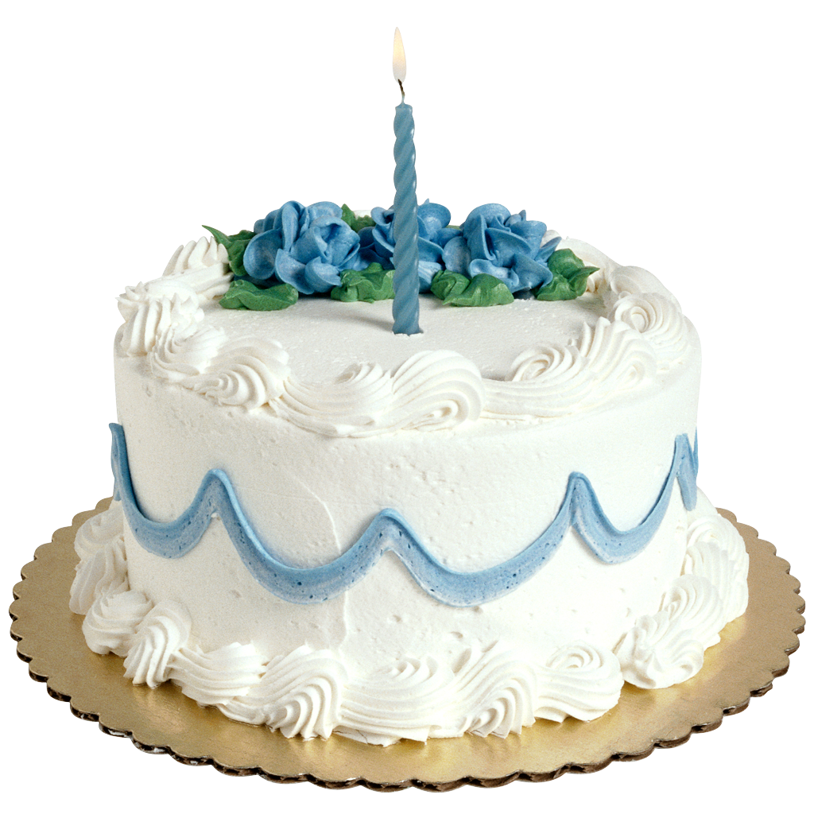
Guess Your Age
Volunteer is handed several cards with “random” numbers written on them
  Returns the cards with age listed on them
Magician glances and says the person’s age
Source: Math Magic
A
8 9 10 11 12 13 14 15
13
B
4 5 6 7 12 13 14 15
C
2 3 6 7 10 11 14 15
A, B, D
D
1 3 5 7 9 11 13 15

Slide 37
How it Works; What Students Learn
Mechanics
  Every card is a column in the binary table
    E.g., “2¹ = 2 card has
    { 2, 3, 6, 7, 10, 11, 14, 15 }
  The first number in the list is the number of the card.
  Just add those together
Students Learn
  Intro to Algorithms
  Binary numbers
  Encoding
  Lookup table for quick calc!
A B C D
N | 2³ | 2² | 2¹ | 2⁰
0 | 0 | 0 | 0 | 0
1 | 0 | 0 | 0 | 1
2 | 0 | 0 | 1 | 0
3 | 0 | 0 | 1 | 1
4 | 0 | 1 | 0 | 0
5 | 0 | 1 | 0 | 1
6 | 0 | 1 | 1 | 0
7 | 0 | 1 | 1 | 1
8 | 1 | 0 | 0 | 0
9 | 1 | 0 | 0 | 1
10 | 1 | 0 | 1 | 0
11 | 1 | 0 | 1 | 1
12 | 1 | 1 | 0 | 0
13 | 1 | 1 | 0 | 1
14 | 1 | 1 | 1 | 0
15 | 1 | 1 | 1 | 1
A, B, D
8+4+1
13

Slide 38
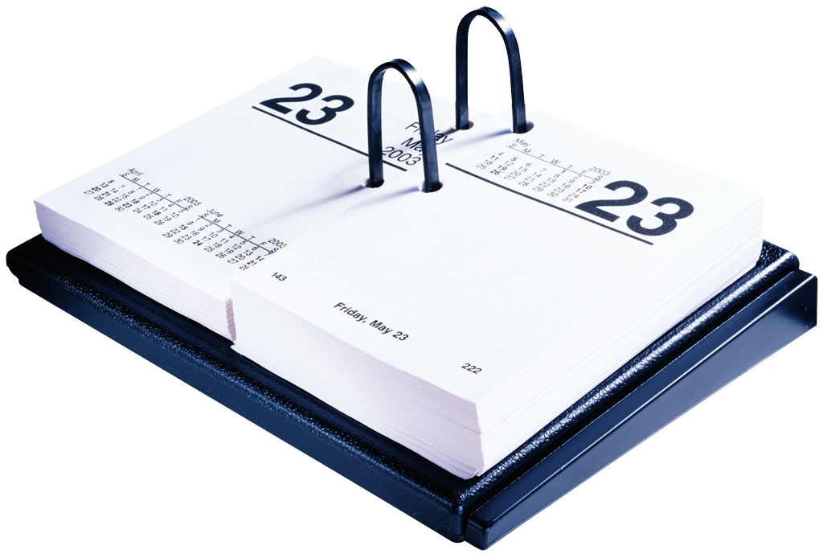
Guess the birthday day of the week
Volunteer is asked for their birthday
Magician says what day of the week it was
Source: en.wikipedia.org/wiki/Zeller%27s_congruence
“June 23, 1912”
Thu

Slide 39
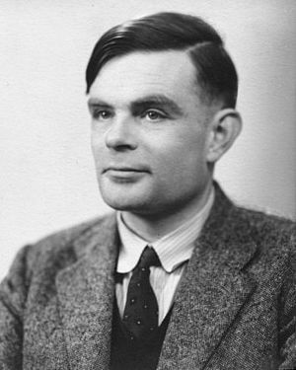
How it Works
What they learn: Don’t nec generalize
  Alg, value of lookup table, modulo
Mechanics
  Complicated general alg:
  Easier: M, D, Y in 1900s
    Turing: June 23, 1912 (6/23/12)
    Sunday!
Algorithm
  If M =1 or 2, Y = Y - 1
  (F(M) + D + Y + Y/4) % 7
    1-index: 1=Mon, 2=Tue, etc.
    Y/4 fast by 20s: 0,5,3,1,-1
  Example
    (4+23+12+3) % 7
    (4 + 2 + -2 + 3) = 7 (Sunday!)
M | F(M) | My memory trick
1 | 1 | “1 and 3 pass through”
2 | 4 | 24 hours in a day
3 | 3 | “1 and 3 pass through”
4 | 6 | 4-6 are flips
5 | 7 | Heinz 57 sauce
6 | 4 | 6-4 are flips
7 | 6 | Spirit of 76
8 | 2 | 8 is made up of 2s
9 | 5 | Working 9-to-5
10 | 0 | Only # with 0 … is 0!
11 | 3 | 11 in Binary is 3
12 | 5 | Working 12-5 (afternoons)
Y | Y/4%7
0 | 0
20 | 5
40 | 3
60 | 1
80 | -1

Slide 40
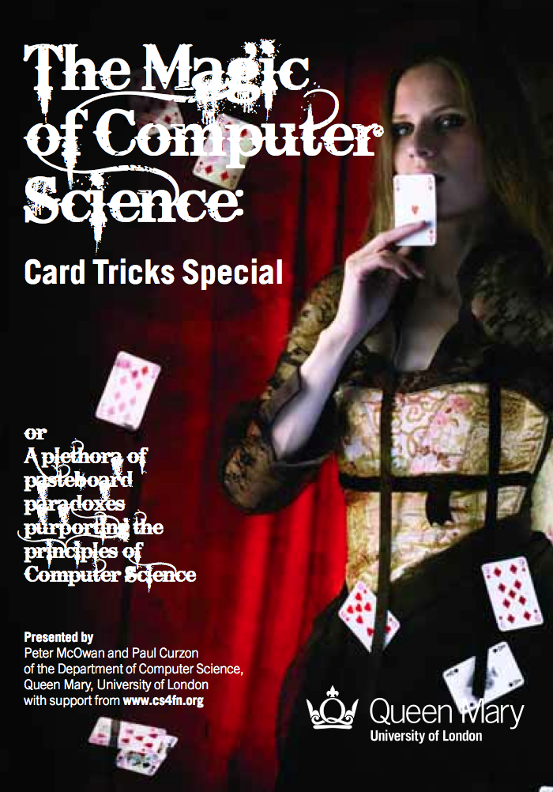
Great Resource : CS4FN
www.cs4fn.org/magic
Paul Curzon, Peter McOwan, Jonathan Black @ Queen Mary, University of London
  CS4FN magazine
  Two free books on Magic and CS!
  Some online apps
If you’d like to contribute tricks, contact them…

Slide 41
Great Resource : Math Magic
www.cs4fn.org/magic
Kids Labs, $12
They include dice, cards, calculator, templates, …
  Some of our tricks we demonstrated today were from this great resource!
www.parents-choice.org/product.cfm?product_id=29300

Slide 42
And in conclusion…
Magic May be Used to
Motivate, Illustrate, and Elaborate on:
- Computing notions
- Problem solving
- Divergent Thinking
Audience Participation
Do YOU have any magic to share?

